Slide 1




Software Tool Time

Slide 2


Slide 3
WebGL 2
biztripcru@gmail.com
© 2025, biztripcru@gmail.com, All rights are reserved.

Slide 4
WebGL 2 Tutorial (Part 3) – Render to Texture
강사
경북대학교 백낙훈 교수
목표
WebGL 2 Render to Texture
Code
https://github.com/hwan-ajou/webgl-1.0.git

Slide 5
Contents ^{내용}
Render to Texture
Render to Texture 시나리오
Render to Texture 프로그램
Mixing RBO and Texture

Slide 6
Render to Texture

Slide 7
Render to Texture
render to texture
FBO 에서 texture memory를 attach 시킨 경우
texture memory
그래픽 카드 내에서 texture image 저장 전용으로 설계된 memory
draw 후에, fragment shader 에서 texture 함수로 read 가능
application areas:
image processing
GPGPU ^{general purpose GPU processing} → CUDA, OpenCL, 대규모 병렬 컴퓨팅
fragment processing
blend
FBO
draw
texture
texture
© Illustration by biztripcru@gmail.com

Slide 8
Attaching Texture Images
void framebufferTexture2D( GLenum target, GLenum attachment, GLenum texTarget, GLuint texid, GLint level );
attach a texture image to the current FBO
target should be FRAMEBUFFER
attachment is COLOR_ATTACHMENT0, etc.
texTarget is TEXTURE_2D in most cases
texid is the texture unique identifier
if texid == 0, the texture image is detached from FBO
© Illustration by biztripcru@gmail.com
FBO #i
COLOR_ATTACHMENT0
COLOR_ATTACHMENT1
DEPTH_ATTACHMENT
STENCIL_ATTACHMENT
texture object #id
• parameters
• image at level 0
• image at level 1
• image at . . .

Slide 9
Attaching Texture Images
© Illustration by biztripcru@gmail.com
¹ prepare a texture pipeline
² prepare an FBO object
³ attach the texture to FBO
texture object #id
• parameters
• image at level 0
• image at level 1
• image at . . .
texture unit (selected)
• TEXTURE_2D
• TEXTURE_3D
• TEXTURE_CUBE_MAP
. . .
texture memory
gl.framebufferTexture2D( gl.FRAMEBUFFER, gl.COLOR_ATTACHMENT0, gl.TEXTURE_2D, id, 0);
© Illustration by biztripcru@gmail.com
FBO (selected)
OpenGL rendering pipeline
gl.bindFramebuffer()
COLOR_ATTACHMENT0
COLOR_ATTACHMENT1
DEPTH_ATTACHMENT
STENCIL_ATTACHMENT

Slide 10
Render to Texture 시나리오

Slide 11

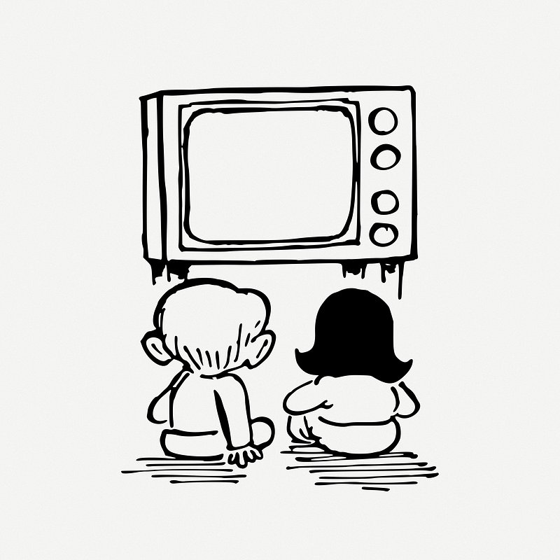
2개의 drawing pipeline
목표 : 방금 그린 image 를 texture image 로 사용
⁰ prepare everything !
¹ draw an image to the texture
² draw the texture on the screen
¹ FBO : render-to-texture
texture object
drawings
CC0, 2024.04.14
https://www.rawpixel.com/image/7675822/psd-face-person-vintage
back buffer / front buffer
CC0, 2022.02.04
https://freesvg.org/dog-with-blue-eyes
texture
² FBO : physical framebuffer
display screen
drawings

Slide 12
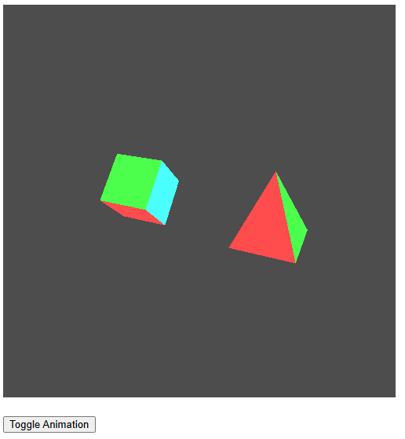
RBO로 전환할 프로그램 선택
rot-two-obj.js
rotating two objects
rtt-rot-two-obj.js
render-to-texture 예제에서는
2개의 drawing pipeline 필요
혼란을 방지하기 위해,
함수 이름에 "rtt_" prefix 적용

Slide 13
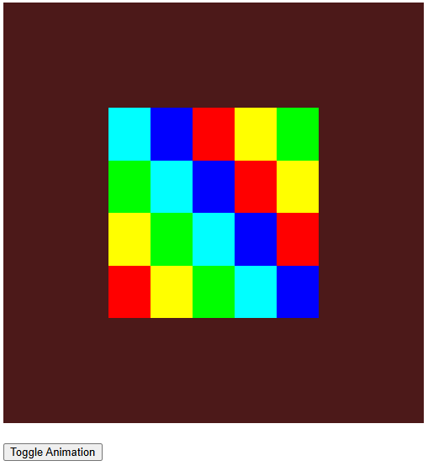
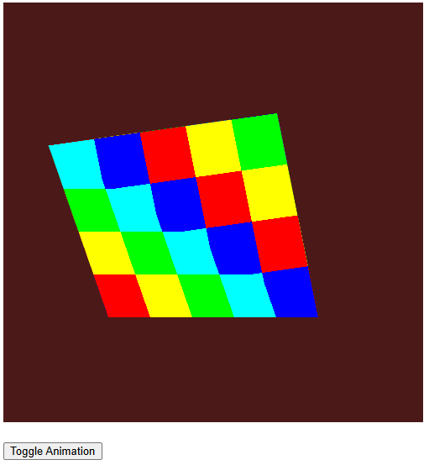

Texture 를 보여줄 프로그램 선택
¹ draw
anim-tex.js : animation 가능
² texture mapping

Slide 14
Render to Texture 프로그램

Slide 15
render-to-tex.js
© Illustration by biztripcru@gmail.com
FBO (selected)
COLOR_ATTACHMENT0
texture unit #0
• TEXTURE_2D
. . .
tex obj color
• image at level 0
. . .
. . .
var texObj_color;
var texObj_depth;
function initFBOandTex() {
. . .
// color buffer
gl.activeTexture(gl.TEXTURE0);
texObj_color = gl.createTexture();
gl.bindTexture(gl.TEXTURE_2D, texObj_color);
gl.texStorage2D(gl.TEXTURE_2D, 1, gl.RGBA8, TEX_W, TEX_H);
gl.texParameteri(gl.TEXTURE_2D, gl.TEXTURE_MIN_FILTER, gl.LINEAR);
. . .
gl.framebufferTexture2D(gl.FRAMEBUFFER, gl.COLOR_ATTACHMENT0, gl.TEXTURE_2D, texObj_color, 0);
COLOR_ATTACHMENT1
DEPTH_ATTACHMENT
STENCIL_ATTACHMENT

Slide 16
render-to-tex.js
© Illustration by biztripcru@gmail.com
FBO (selected)
COLOR_ATTACHMENT0
texture unit #0
• TEXTURE_2D
. . .
tex obj color
• image at level 0
. . .
// depth buffer
texObj_depth = gl.createTexture();
gl.bindTexture(gl.TEXTURE_2D, texObj_depth);
gl.texStorage2D(gl.TEXTURE_2D, 1, gl.DEPTH_COMPONENT24, TEX_W, TEX_H);
gl.texParameteri(gl.TEXTURE_2D, gl.TEXTURE_MIN_FILTER, gl.LINEAR);
gl.framebufferTexture2D(gl.FRAMEBUFFER, gl.DEPTH_ATTACHMENT, gl.TEXTURE_2D, texObj_depth, 0);
// done
gl.bindFramebuffer(gl.FRAMEBUFFER, null);
return testGLError("initFBOandTex");
}
COLOR_ATTACHMENT1
DEPTH_ATTACHMENT
STENCIL_ATTACHMENT
texture unit #1
• TEXTURE_2D
. . .
tex obj depth
• image at level 0
. . .

Slide 17
render-to-tex.js
var flagAnim = 0;
function toggleAnim() {
flagAnim ^= 1;
console.log("flagAnim=", flagAnim);
}
function renderScene() {
if (typeof renderScene.theta == 'undefined') {
renderScene.theta = 0.0;
renderScene.dTheta = 0.05;
}
if (flagAnim == 1) {
renderScene.theta += renderScene.dTheta;
}

Slide 18
render-to-tex.js
// rtt part
gl.bindFramebuffer(gl.FRAMEBUFFER, fbo);
rtt_renderScene();
gl.bindFramebuffer(gl.FRAMEBUFFER, null);
// my part
gl.useProgram(gl.progObj);
. . .
// update func part
vertData[2 * 8 + 0] = -map_size_x + 0.2 * Math.cos( 1.25 * renderScene.theta ) - 0.2;
vertData[2 * 8 + 1] = +map_size_y + 0.2 * Math.sin( 1.25 * renderScene.theta );
vertData[3 * 8 + 0] = +map_size_x + 0.1 * Math.cos( 1.00 * renderScene.theta ) - 0.1;
vertData[3 * 8 + 1] = +map_size_y + 0.1 * Math.sin( 1.00 * renderScene.theta );
gl.bufferData(gl.ARRAY_BUFFER, new Float32Array(vertData), gl.STATIC_DRAW);
. . .
}
render to texture
texture animation on the screen

Slide 19
render-to-tex.js
function main() {
var canvas = document.getElementById("canvas");
initGL(canvas);
initFBOandTex();
rtt_initBuf();
rtt_initShaders();
initBuf();
initShaders();
requestAnimFrame = (function () {
return window.requestAnimationFrame || window.webkitRequestAnimationFrame ||
window.mozRequestAnimationFrame ||
function (callback) {
window.setTimeout(callback, 1000, 60);
};
})();
. . .
}

Slide 20
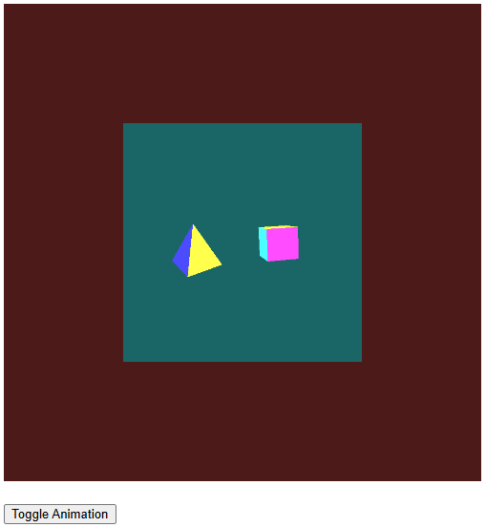
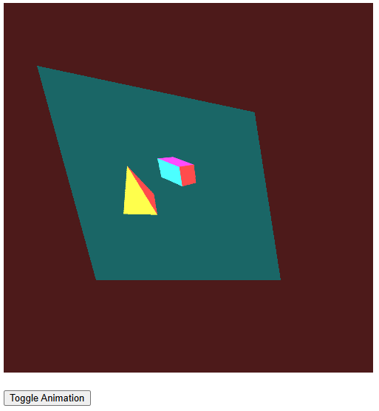
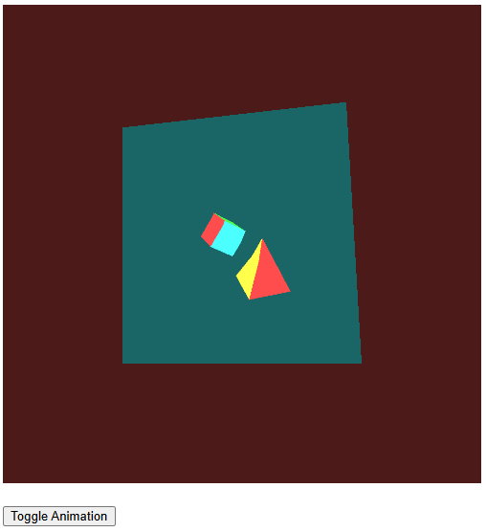
실행 결과
시간 ^{time}

Slide 21
Mixing RBO and Texture

Slide 22
FBO 에서 RBO, Texture 동시 사용
FBO 에서
color buffer → texture memory를 attach
depth buffer → RBO 를 attach
그 반대도 가능
RBO 내용을 다시 화면에 출력하기는 부적당

Slide 23
rtt-rbo.js
var rbo_depth;
var texObj_color;
function initFBOandTex() {
. . .
// color buffer
texObj_color = gl.createTexture();
gl.bindTexture(gl.TEXTURE_2D, texObj_color);
gl.texStorage2D(gl.TEXTURE_2D, 1, gl.RGBA8, TEX_W, TEX_H);
. . .
gl.framebufferTexture2D(gl.FRAMEBUFFER, gl.COLOR_ATTACHMENT0, gl.TEXTURE_2D, texObj_color, 0);
// depth buffer
rbo_depth = gl.createRenderbuffer();
gl.bindRenderbuffer(gl.RENDERBUFFER, rbo_depth);
gl.renderbufferStorage(gl.RENDERBUFFER, gl.DEPTH_COMPONENT24, TEX_W, TEX_H);
gl.framebufferRenderbuffer(gl.FRAMEBUFFER, gl.DEPTH_ATTACHMENT, gl.RENDERBUFFER, rbo_depth);
. . .
}

Slide 24
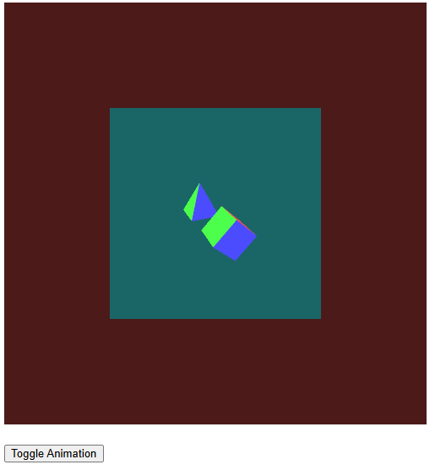
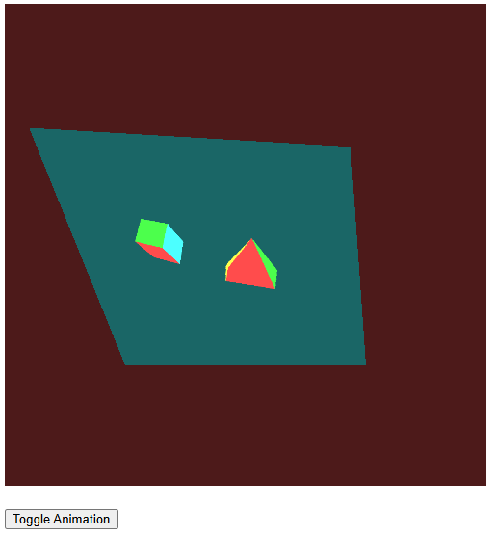
실행 결과
시간 ^{time}

Slide 25
Your Challenge
dual color output
color attachment #0 와 #1을 동시에 연결해서, 한꺼번에 그리기 가능
output depth buffer
depth buffer를 texture로 설정해서 화면 출력 가능

Slide 26
Contents ^{내용}
Render to Texture
Render to Texture 시나리오
Render to Texture 프로그램
Mixing RBO and Texture

Slide 27
Software Tool Time (소프트웨어 툴 타임)
(CC-BY-NC 4.0) KNU and Ajou Univ.
Visit “Software Tool Time” channel in YouTube : https://www.youtube.com/c/SoftwareToolTime
All product names, trademarks, and/or company names are used solely for identification and belong to their respective owners.
“Software Tool Time” video is licensed to the public under a Creative Commons Attribution 4.0 License (https://creativecommons.org/license/by/4.0/)
Twin Musicom’s African Drums (Sting) is licensed to the to the public under a Creative Commons Attribution 4.0 License (Artist: http://www.twinmusicom.org/)

Slide 29

본 영상은 2021,2022년도 과학기술정보통신부 및 정보통신기획평가원에서 지원하는 SW중심대학사업의 결과물 입니다.
본 영상의 내용을 전재할 수 없으며, 인용할 때에는 반드시 과학기술정보통신부와 정보통신기획평가원의 'SW중심대학사업'의 결과물이라는 출처를 밝혀야 합니다.

